Slide 1
Spectroscopy

Slide 2
Spectra means radiations and Scopy means study.
Spectroscopy is the study of the interaction between electromagnetic radiation and matter.
The matter may be atoms, molecules or ions.

Slide 3





Interaction of electromagnetic radiation
With matter

Slide 4
Significance of the study of Spectroscopy
Used in Astronomy to find the availability of minerals, water etc.
Used in Large spectroscopes which are used to find out the chemical compositions and physical properties of Astronomical objects
In medical field (ECG, X -Ray, MRI etc.)
Used in the quantitative and qualitative analysis of chemical substances.

Slide 5
Advantages of the spectroscopic Techniques
Less time is required.
The measurement is very accurate.
Requires very small amount of the sample.
After recording the spectra ,the sample can be reused.

Slide 6
Spectrometer
Spectrometer is an instrument which can be used to measure the presence of particular compound or particle in a molecule.

Slide 7
Spectrum
Spectrum is a plot of the amount of light absorbed by a sample versus the wavelength of the light.
The amount of light absorbed is called the absorbance.

Slide 8
Electromagnetic radiation
An electromagnetic radiation is a radiant energy emitted from any source in the form of light, heat or sound.

Slide 9
Characteristics of Electromagnetic Radiation
Electromagnetic radiation possess particle nature as well as wave nature. A light beam consists of stream of particles (photons) moving in the form of waves.
2. Electromagnetic radiations travel with the velocity of light.i.e.2.998x10⁸
3. The electromagnetic waves have electric and magnetic fields associated with them at right angles to one another. If the radiation is moving along the X axis, the magnetic field is oriented along the Y axis and electric field is oriented along the Z axis.
³

Slide 10
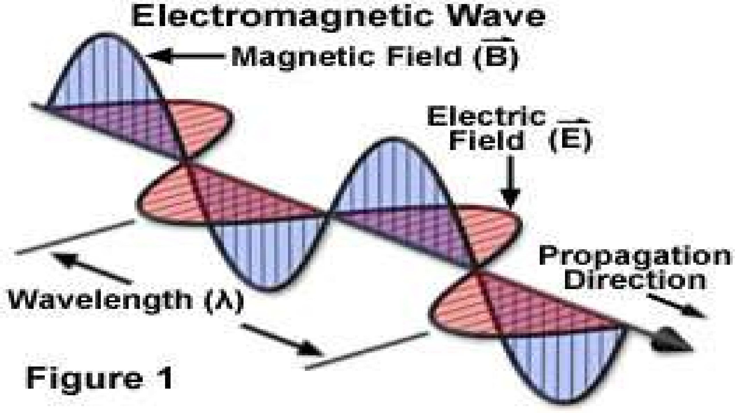

Slide 11
Electomagnetic spectrum
The whole range of frequencies/wavelength of the electromagnetic radiations arranged in an order is known as Electromagnetic spectrum.
Radio waves
Microwaves
Infrared rays
Visible light
Ultraviolet light
X-Rays
Gamma Rays

Slide 12
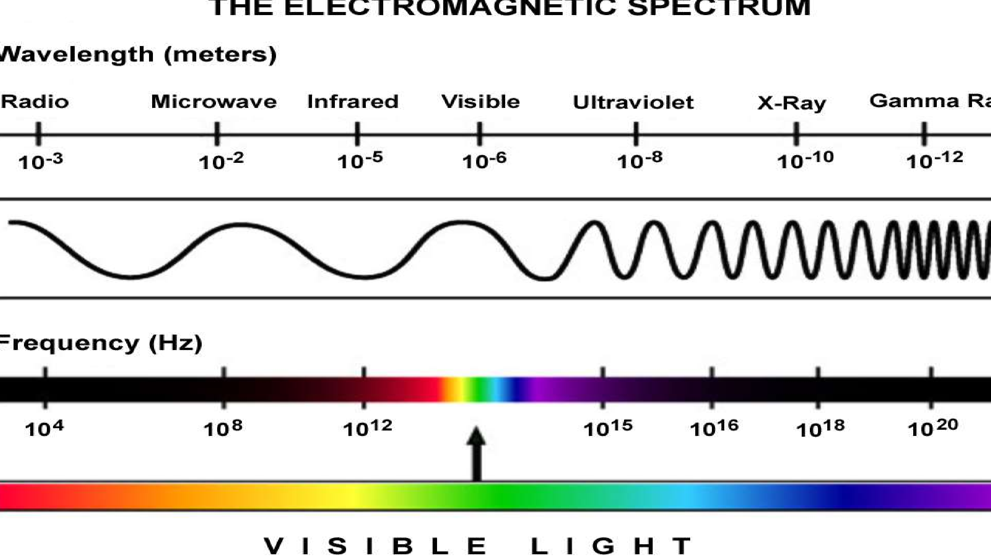

Slide 13
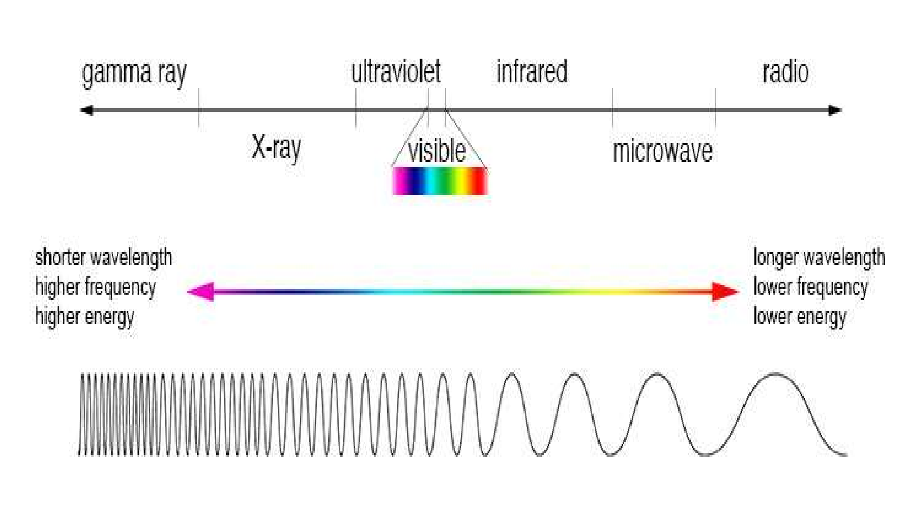

Slide 14
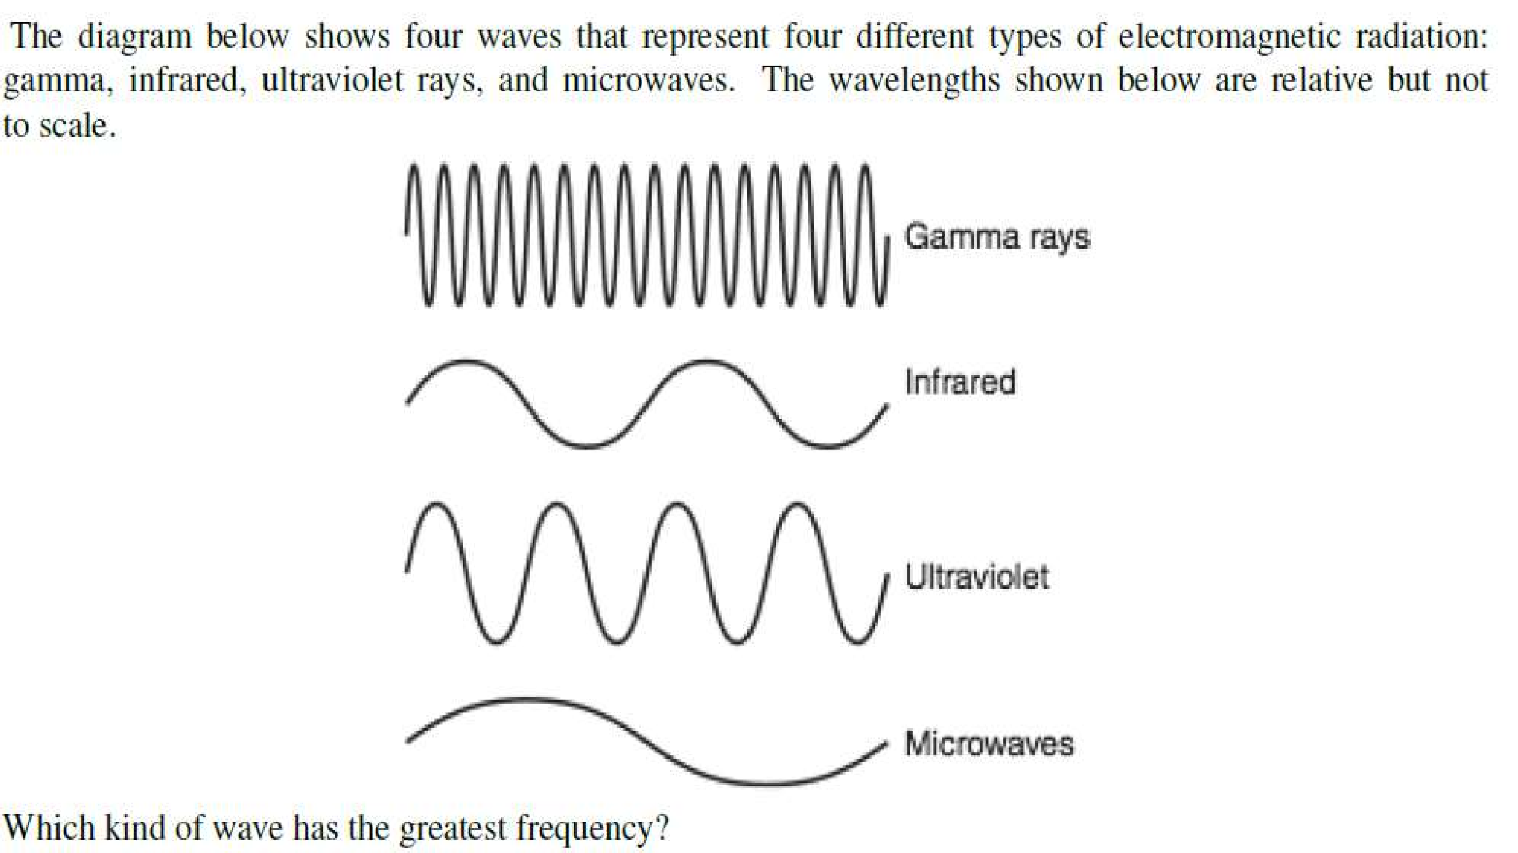

Slide 15
Electromagnetic spectrum
Electromagnetic spectrum ranges from very short wavelength (gamma rays) to very long wavelengths(radio waves).
The visible region of the spectrum extends approximately over the wavelength range 400-700nm.
The shorter wavelength being the blue end of the spectrum and the longer wavelength the red.

Slide 16
Electromagnetic spectrum
The wavelength between 400 and 200nm make up the near ultraviolet region of the spectrum.
The wavelength above 700nm to approximately 2000nm the ultraviolet region.

Slide 17
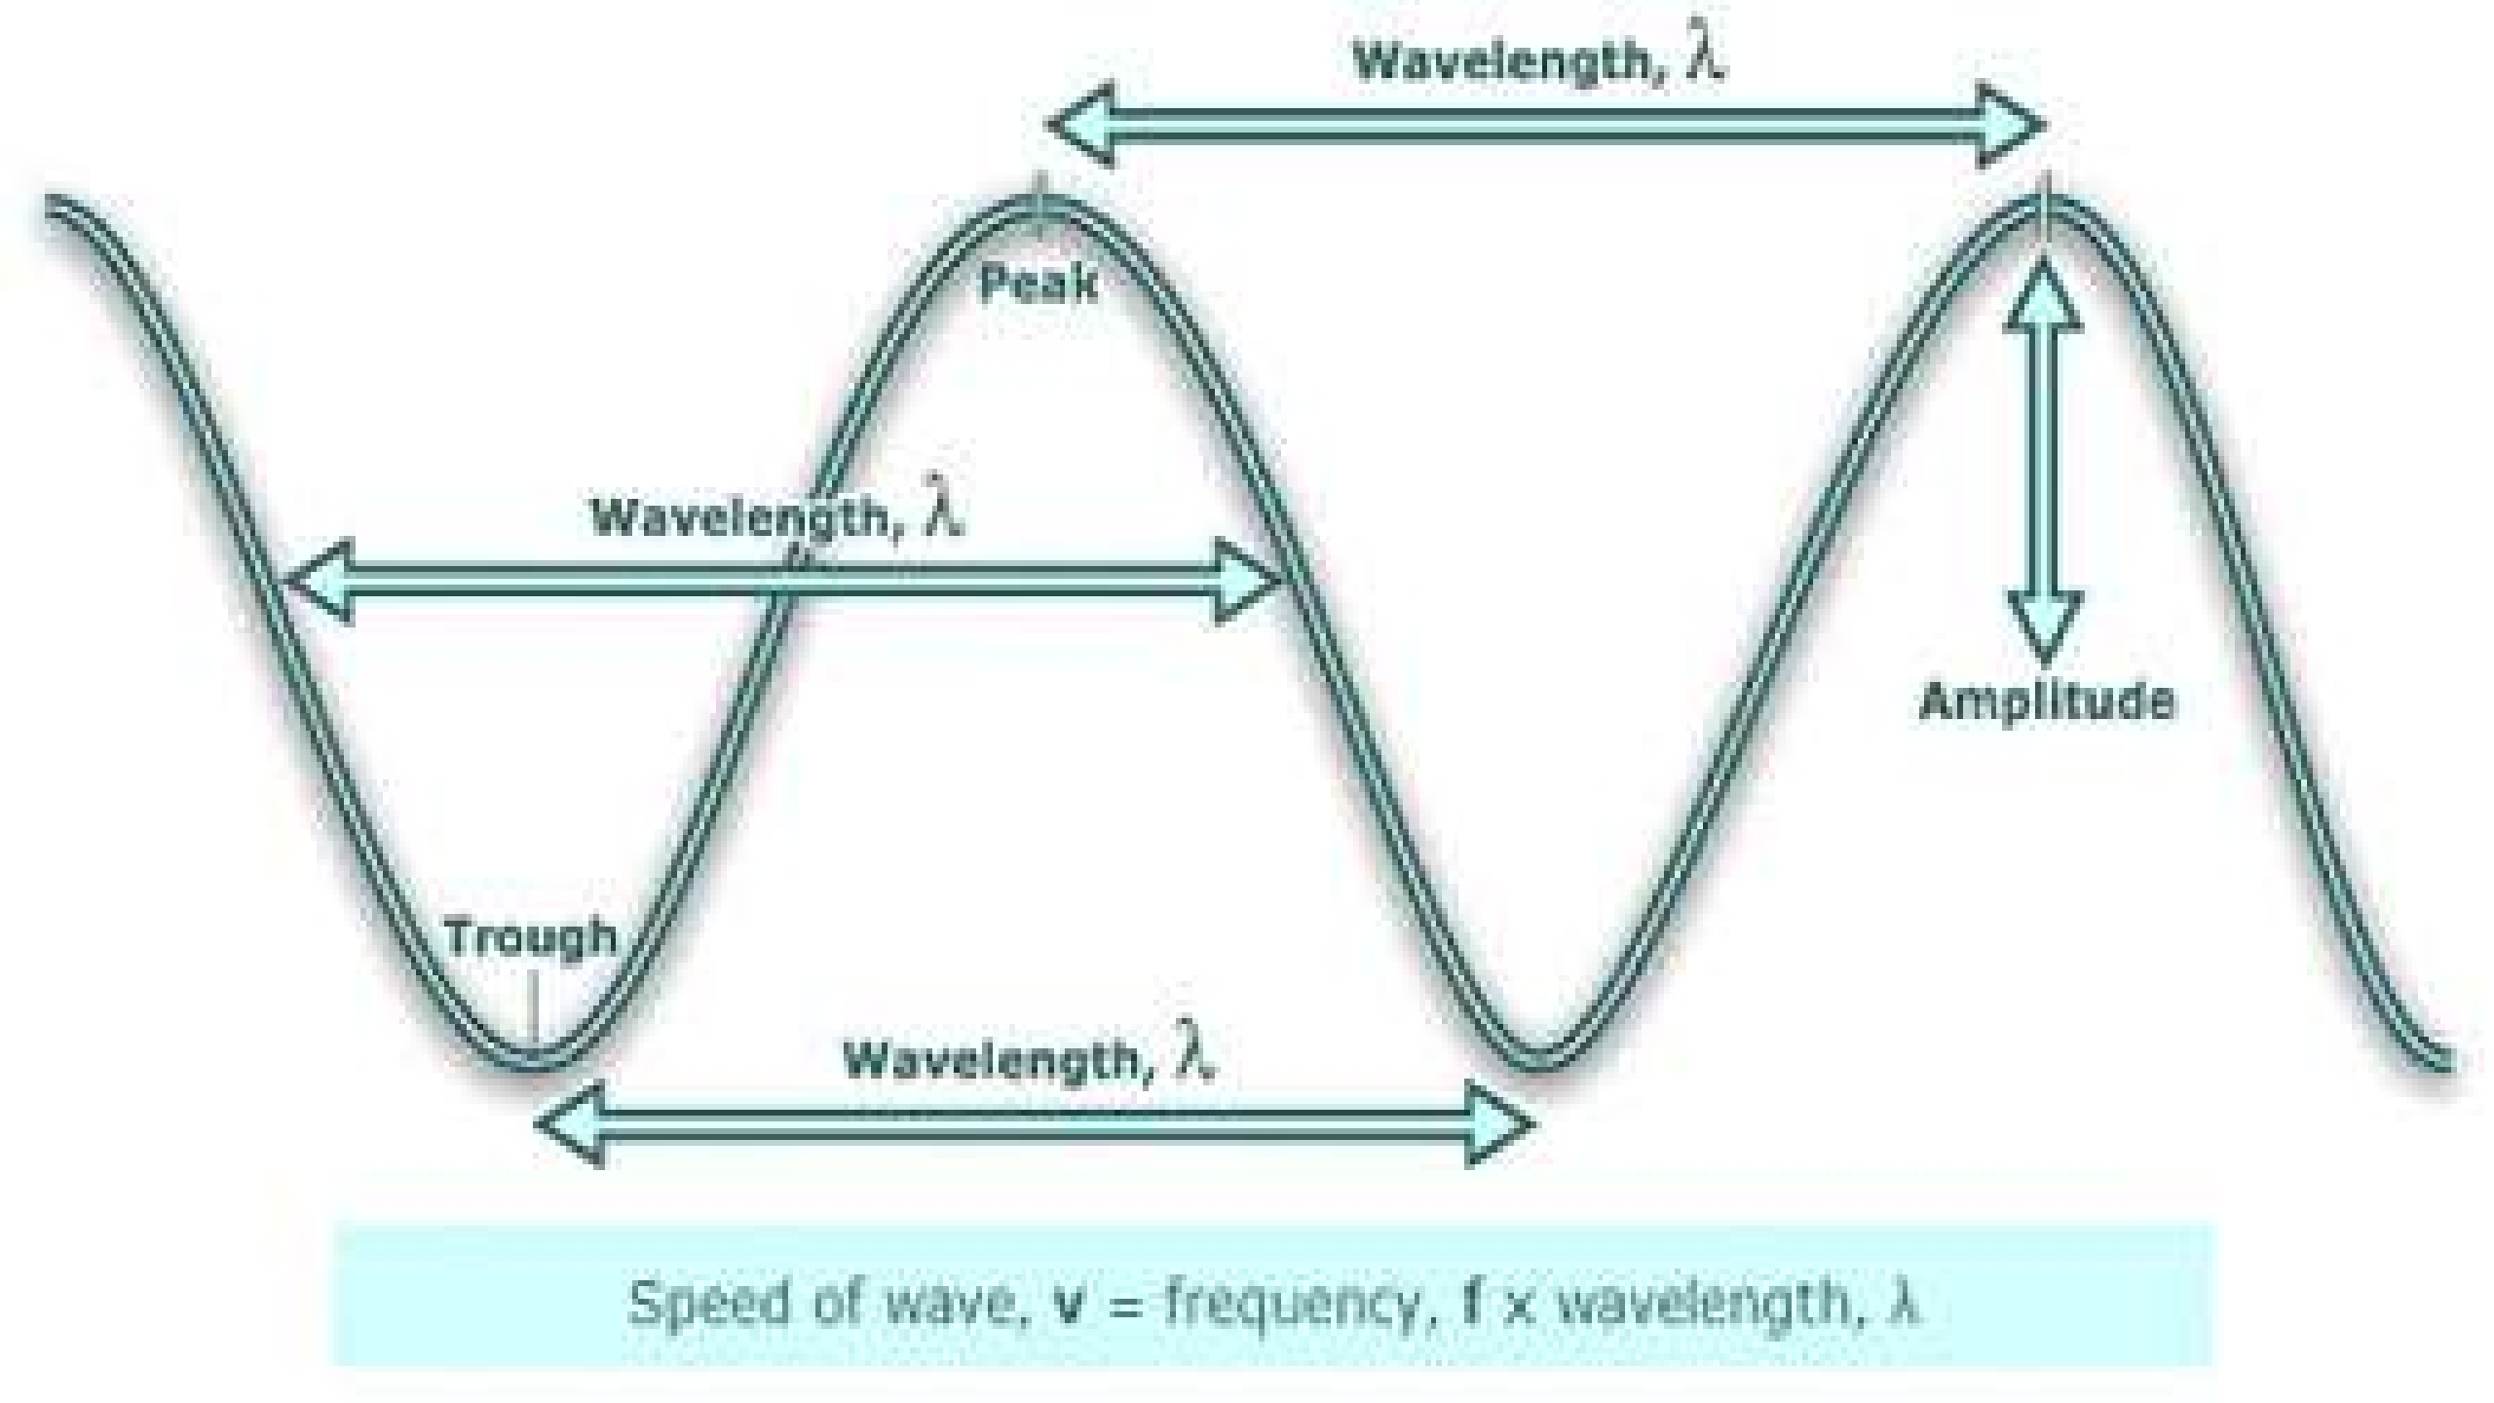

Slide 18
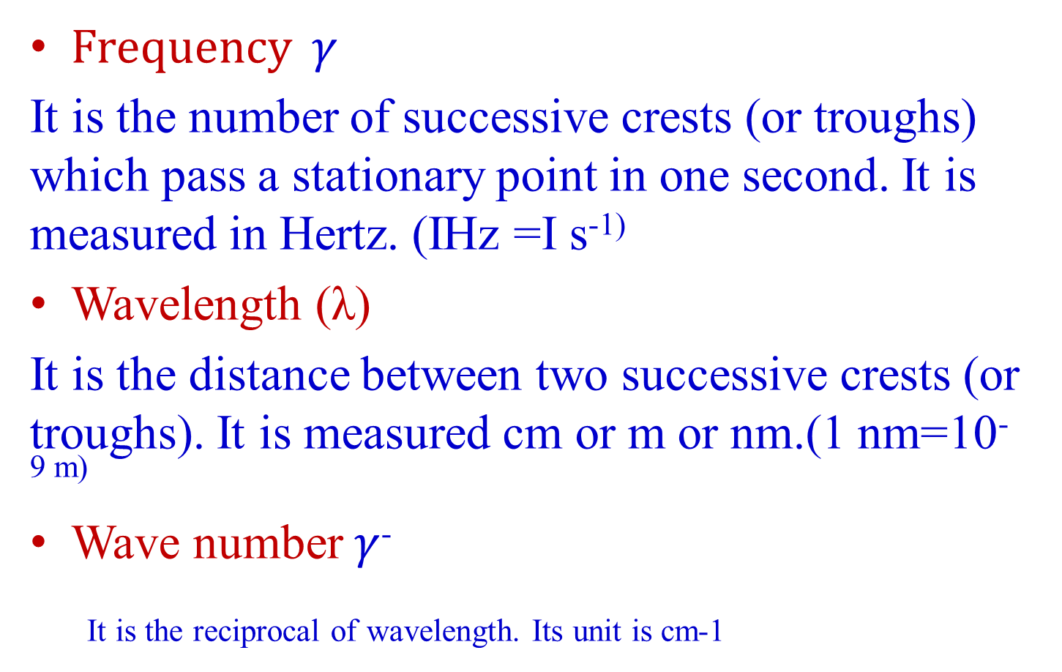
Various terms...
Frequency $γ$
It is the number of successive crests (or troughs) which pass a stationary point in one second. It is measured in Hertz. (IHz =I s⁻¹⁾
Wavelength (λ)
It is the distance between two successive crests (or troughs). It is measured cm or m or nm.(1 nm=10^{-9 m)}
Wave number $γ$⁻
It is the reciprocal of wavelength. Its unit is cm-1

Slide 19
Rotational ,Vibrational and Electronic Energies of Molecules
Rotational Energy
It involves the rotation of the molecules or part of the molecules about the centre of gravity.
Vibrational Energy
It is associated with stretching, contracting or bending of covalent bonds in molecules. The bond behave as spirals made of wire.
Electronic Energy
It involves changes in the distribution of electrons by splitting of bonds or the promotion of electrons into higher energy.

Slide 20
The nature of the interaction between radiation and matter may include-
Absorption
Emission
Scattering
They help in the study of matter with respect to
Qualitative study
Quantitative study

Slide 21
Interaction with matter...
The effect of electromagnetic radiation on interaction with matter depends on energy associated with the radiation.
Very energetic radiations (UV and X-ray) may cause an electron to be ejected from the molecules.
Radiation in the infrared region of the spectrum have much less energy they can cause vibrations in molecules.

Slide 22
Interaction with matter...
Microwave radiation is even less energetic than infrared radiation it can neither induce electronic transition in molecules nor can it cause vibrations it can only cause molecules to rotate.
Ultraviolet, visible - electronic transitions
Infrared - molecular vibrations
Microwave - molecular rotation

Slide 23
Types of spectroscopy
When radiation meets matter, the radiation is either scattered, emitted or absorbed. So there are of three types of spectroscopy.
Absorption spectroscopy
Scattering spectroscopy
Emission spectroscopy

Slide 24
Absorption spectroscopy
In absorption spectroscopy an electromagnetic radiation is absorbed by an atom or molecule
Which undergoes transition from a lower energy state to a higher energy or excited state.
Absorption occurs only when the energy of radiation matches the difference in energy between two energy levels.

Slide 25
Scattering spectroscopy
Scattering spectroscopy measures certain physical properties by measuring the amount of light that a substance scatters at certain wavelengths .
One of the most useful applications of light scattering spectroscopy is RAMAN SPECTROSCOPY.

Slide 26
Emission spectroscopy
Atoms or molecules that are excited to high energy levels can decay to lower levels by emitting radiation.
The substance first absorbs energy and then emits this energy as light.
Emission can be induced by sources of energy such as flame or electromagnetic radiation.

Slide 27
Atomic Spectroscopy Vs Molecular Spectroscopy
Atomic Spectroscopy
In the case of atoms, electrons jump from a lower orbit to a higher orbit. When they start coming back to the lower orbit, emission of energy equal to the difference in the energies of the two orbitals takes place in the form of atomic spectrum.
Atomic spectra helps in the study of structure of atoms.

Slide 28
Molecular Spectroscopy
In the case of molecules, when the energy is absorbed, it may result into rotation, vibration or electronic transition depending upon the amount of energy absorbed.
The rotational ,vibrational and the electronic energy levels of the molecule are collectively called as Molecular Energy Levels.
The transition of energies taking place between these energy levels result in Molecular Spectra.

Slide 29
Molecular spectra gives information about the structure and properties of molecules such as bond lengths, bond angles, bond strength, shapes, dipole moments etc.

Slide 30
Electronic, Vibrational and Rotational Energy levels
Each electronic level consists of a number of vibrational sublevels.
Each vibrational energy level consists of a number of rotational sublevels.
Therefore when a electron jumps from one electronic energy level to another electronic energy level, it is accompanied by the transition between vibrational as well as rotational energy levels.
E_{electronic} >> E_{vibrational} >> E_{rotational}

Slide 31
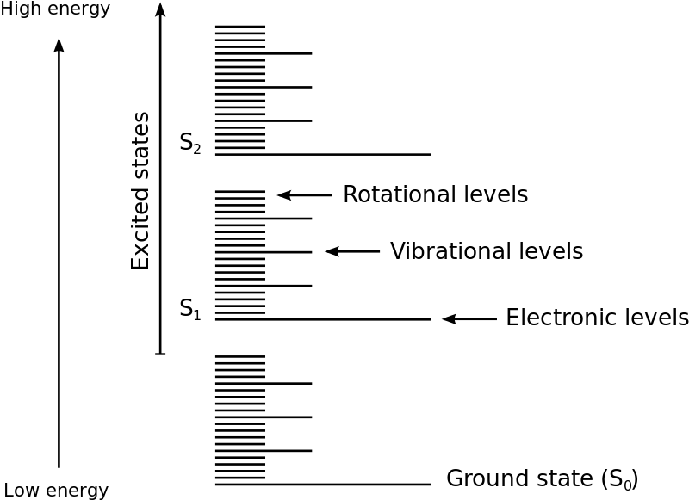
Molecular Energy Levels

Slide 32
Types of Molecular Spectra
Pure Rotational Spectra(Microwave spectra)
If the energy absorbed by the molecule is such that it can cause transition from one rotational energy level to another rotational energy level within the Vibrational level, the result obtained in Rotational spectrum. These spectra are obtained in the microwave region and the spectra obtained is called Microwave spectra.

Slide 33
Vibrational Rotational Spectra(Infrared Spectra)
If the energy observed by the molecule is sufficiently large so that it causes the transition from one vibrational energy level to another vibrational energy level within the same electronic level. At the same time since the energy required for the transition from one rotational level to another is small than the vibrational energy, transition also happens from one rotational level to another rotational level. Such energies are obtained in the near Infra red region and the spectrum obtained is called Infra red Spectrum

Slide 34
Electronic spectra
If the incident energy is higher such that it can result in a transition from one electronic level to another, then this will also be accompanied by vibrational changes and each of these is further accompanied by rotational level changes. The spectra thus obtained is called Electronic spectra. This spectra is observed in the Visible and Ultraviolet region.

Slide 35
Basic Principles of UV-Vis absorption Spectroscopy
UV-Vis spectroscopy used light in the UV and Visible part of the electromagnetic spectrum.
Light of this wavelength is able to cause the excitation of electrons in the ground state to higher energy state.
This technique is used to determine the concentration of the analyte.

Slide 36
When a beam of radiation passes through a substance or a solution, some of the light may be absorbed and the remaining light is transmitted through the sample. The ratio of the intensity of ligt entering the sample I₀ to that exiting the sample I at a particular wavelength is defined as Transmittance T.

Slide 37
Principles of absorption spectroscopy
A = - log (T)
Absorption of light by a sample

Slide 38
Beer-lamberts law
The Beer-Lambert law states that the amount of light absorbed by a substance dissolved in a fully transmitting solvent is directly proportional to the concentration of the substance and the path length.
A = a x b x c
where
a = the absorptivity of the substance
b = path length
c = concentration of the substance
When working in concentration units of molarity, the Beer-Lambert law is written as:
A = £ x b x c
Where £ is the wavelength-dependent molar absorptivity coefficient with units of M-1 cm-1.
As, ε and b, both are constant, then it can be written that, A α c

Slide 39
Selection rules
Selection rules are the set of rules which tells us whether a particular transition is allowed among the quantum levels when an electromagnetic radiation is absorbed.

Slide 40
Selection Rules for Electronic Transitions
Spin Selection Rule
∆S = 0
Allowed transitions = Singlet →Singlet;
Triplet →Triplet
Forbidden transitions= Singlet →Triplet;
Triplet →Singet
Changes in spin multiplicity are forbidden
2. Laporte Selection Rule
There must be change in the parity (symmetry)of the complex.
Lapporte Allowed transitions g→u ; u→g
Lapporte forbidden transitions g→g ; u→u
‘g’stands for gerade . Gerade means compound with centre of symmetry
‘u’ stands for ungerade . Ungerage means compound without centre of symmetry

Slide 41
Rotational Spectra
The rotational or microwave spectroscopy was discovered by Cleeton and Williams in 1934.
It explored the microwave region of the electromagnetic spectrum that covers the frequency range from 3 to 300 GHz.

Slide 42
Conditions to obtain pure rotational spectrum
For microwave absorption, the molecule must possess a permanent dipole moment. A rotating heteronuclear diatomic molecule such as HC1 (or CO, NO, H₂O etc.) will give rise to a sinusoidally varying component of electric dipole moment vector, which can interact with the electric field vector of the microwave radiation.
Hence, heteronuclear diatomic and polyatomic molecules with permanent dipole moment give rise to a spectrum and are said to be microwave active.

Slide 43
However,the homonuclear diatomic molecules such as H₂, N₂, O₂, Cl₂ which do not have permanent dipole moment (or dipole moment is zero) do not give pure rotational spectra and are said to be microwave inactive.

Slide 44
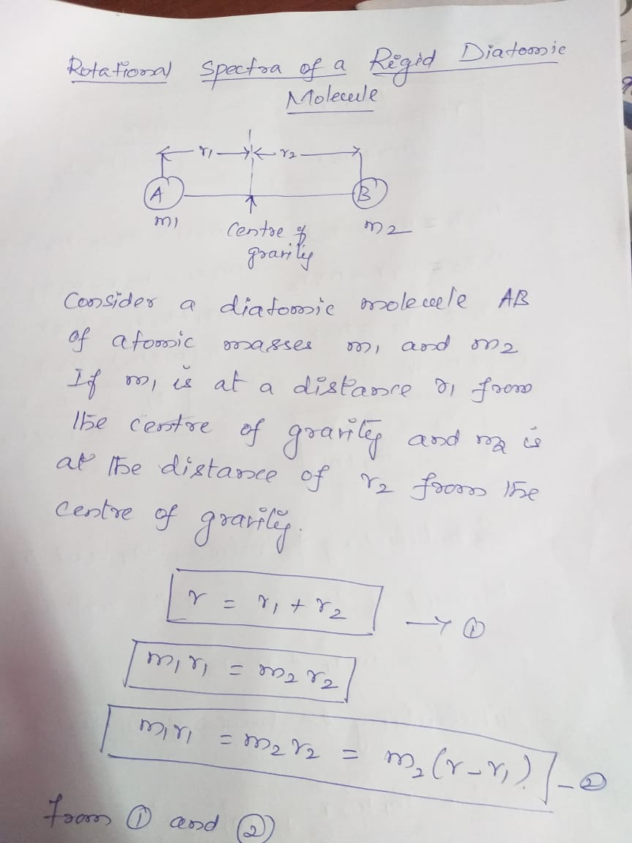

Slide 45
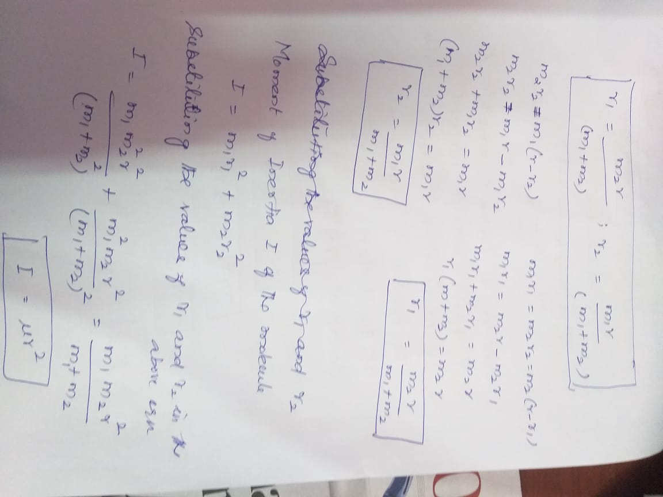

Slide 46
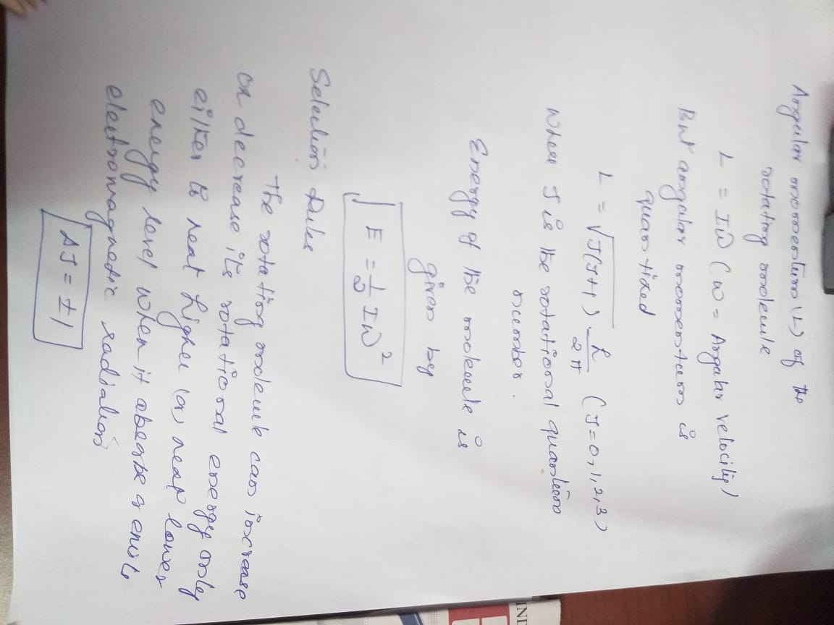

Slide 47
VIBRATIONAL (INFRA RED) SPECTROSCOPY
Simple harmonic oscillator (Vibrational motion)
The vibrational motion resembles the motion observed for a ball attached to a spring that is harmonic oscillator which obeys Hook’s law. That is the force, the spring exerts on the particle is a proportional to displacement from the equilibrium position, x(x=0). Hook’s law relates the restoring force, F as F=-fx where f is a force constant. Therefore, the potential energy of the particle will be
V(x)=-Fdx or V(x)= ∫ fx dx
Thus V(x)=1/2 fx²

Slide 48
Application of Newton’s second law gives the familiar equation of simple harmonic motion. The equation of motion according to classical mechanics is
F= md²x / dt²
Hence, restoring force md²x / dt²= -fx

Slide 49
Vibrational motion of a diatomic molecule

Slide 50
Vibrational motion of a diatomic molecule
The displacement coordinates are x₁ and x₂ in Fig. The extension of the spring is (x₂-x₁). The restoring force is then given by
F=-f(x₂-x₁), f is a force constant .......... (1)
The motion can be expressed in terms of Newton's law as follows:
.......... (2)
Similar equations can be written for compression. The solution of these equations (like harmonic oscillator) shows that
.......(3)
where v₀ is the fundamental natural frequency of the system and μ is the reduced mass of the two particle system. Here the fundamental frequency depends on the force constant and the reduced mass of the system.

Slide 51
Vibrational motion of a diatomic molecule
According to the quantum mechanical model, the potential energy is given by
V(x) = l/2f(x2-x1)2 .......(4)
Substituting it in the Schrodinger wave equation we get
.......(5)
where the displacement x=(x2-x1). Thus the vibrational energy of diatomic molecule is
.......(6)
v is called the vibrational quantum number and the frequency v0 is given by equation (3). Converting energy into spectroscopic units, cm-1, we get
.......(7)

Slide 52
Vibrational motion of a diatomic molecule
Different values of vibrational quantum number, v can be derived from equation (7).

Slide 53
NMR SPECTROSCOPY
The phenomenon of Nuclear Magnetic Resonance was enunciated by American Physicist, Felix Bloch (Standford University)and Edward Purcell(Harvard University).
Awarded Nobel prize in 1952.
Applications:
Radiation Chemistry, Photo chemistry, Structural Inorganic Chemistry, Organic Chemistry, study of rapid equilibrium processes and numeruos applications

Slide 54
MRI (Magnetic Resonance Imaging)
This employs Nuclear magnetic resonance of protons to produce proton density maps of the human body.
MRI can be used to discriminate between healthy and diseased tissues of the body.
It is based on the fact that the protons present within water, lipids, fats etc, resonate at a given frequency.
Since human body contains 75 % of water and each water molecule has two hydrogen atoms, the images of the different parts of the body can be taken.
In a diseased condition of the body, the constitution of the water, fats and lipids alters and hence the diseased part can be identified.

Slide 55
NMR -Introduction
It has been experimentally found that if any nucleus is containing odd number of proton or neutrons or both ,they have the property of nuclear spin.
For example ¹H,¹³C,¹⁹F nuclei possess nuclear spin.
¹HNMR deals with the nuclear spin associated with the proton.

Slide 56
The spinning of a proton generates a circulating electric field current which in turn produces a magnetic field.
Therefore a spinning proton behaves as a tiny magnet(Gyromagnetism).
When a sample containing nuclei exhibiting this gyromagnetic property is placed in an appropriate DC magnetic field and is simultaneously irradiated with radiofrequency magnetic field, the nuclei is compelled to

Slide 57
1.Reveal their presence
2.Identify themselves
3. Describe the nature of their surroundings

Slide 58
Principle of NMR Spectroscopy
The nucleus of hydrogen atom behaves like a tiny bar magnet because it possess both electric and magnetic field.
Consider a spinning Top. It performs a slower waltz like motion in which the spinning axis of the top moves slowly around the vertical axis. This motion is called as the Processional motion.
Similarly the proton will also Precess.

Slide 59
Nuclear Resonance
In NMR experiment , a strong homogeneous magnetic field is applied causing the nuclei to precess.
Then radiation of energy from radiofrequency source is applied.
When the radiation energy becomes equal to the Larmor frequency or angular frequency of precession, the two are said to be in resonance.
Due to this resonance, some nuclei are excited from low energy state to high energy state by the absorption of energy from radio frequency.

Slide 60
Chemical shift
The number of signals in the NMR tells us about the different types of proton in a molecule.
The position of the signals help us to know the nature of protons such as aliphatic, aromatic, phenolic, protons. These protons have different electronic environments and therefore they absorb at different field strengths.

Slide 61
Shielding and Deshielding effect
When a molecule is placed in a magnetic field, its electrons circulate and thus produce secondary magnetic field i.e. Induced magnetic field. Rotation of electrons about the proton itself generates a field which opposes the applied field. Hence the field felt by the proton is diminished and the proton is said to be shielded .If the induced magnetic field opposes the applied field the proton is said to be shielded.
If the induced magnetic field reinforces the applied field, the proton is said to be deshielded.

Slide 62
Chemical shift
The difference in the absorption position of a particular proton from the absorption position of a reference proton is known as Chemical shift. Or
In other words, the shifts in the position of NMR absorptions which arise due to the shielding or deshielding of protons by electrons are called Chemical shifts.

Slide 63
TMS as Reference compound
TMS is Tetramethyl Silane Si(CH₃)₄
It has 12 equivalent protons.
Since all are there in the same encironment,TMS givesa single intense peak inits NMR Spectrum.
It has a low boiling point(27⁰C) and thus can be easily recovered after the spectrum is recorded.
It is chemically inert.
It shows a very high magnetic strength compared to other protons.
Values of Chemical shift in two values.

Slide 64
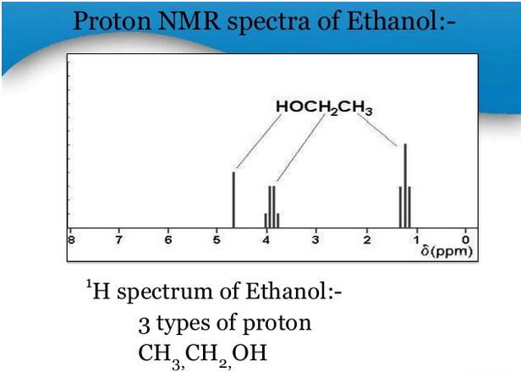

Slide 65
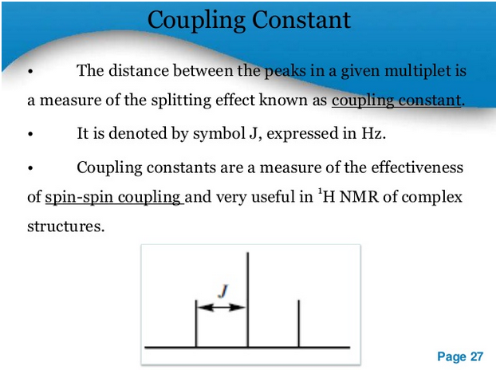

Slide 66
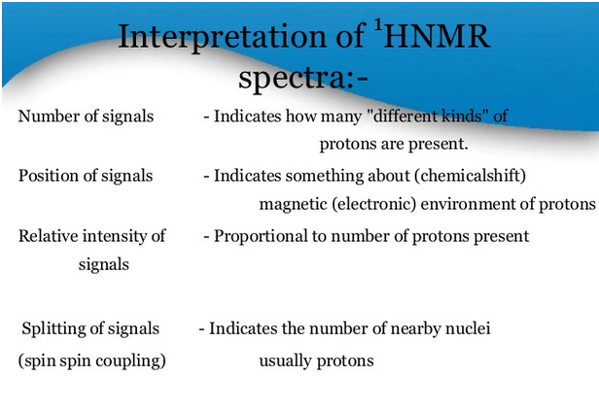

Slide 67
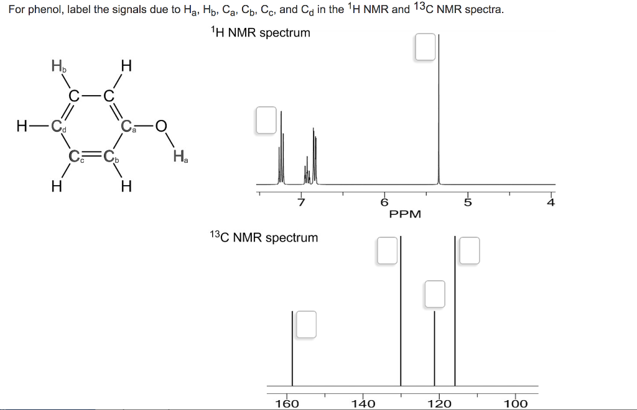
Proton NMR and Carbon NMR

Slide 68
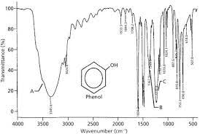
IR SPECTRA OF PHENOL

Slide 69
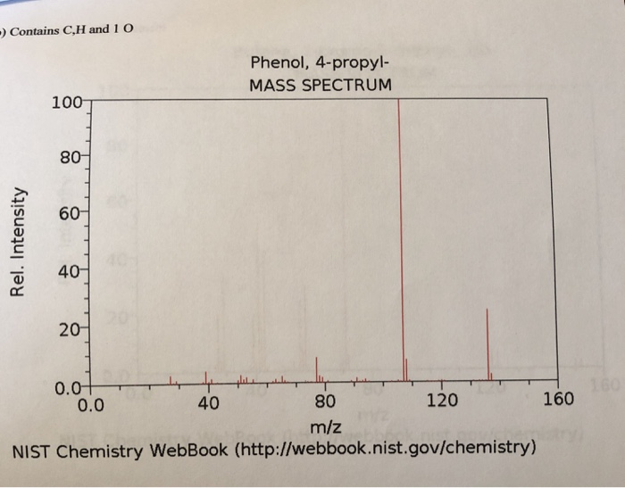
Mass Spectra

